Slide 1


ABC Wireless Inc.
CHURN PREDICTION INITIATIVE: OVERVIEW
JULY 11, 2025
SUBMITTED BY:
ELIZABETH CRAWLEY, MATT MILLER, AND HOLLY VICTOR
Notes:
Hello, we’re Group 2 and today we’ll walk you through our churn prediction project for ABC Wireless. We’ll explore what drives churn, how we modeled it, and what ABC can do about it.

Slide 2


Project Objective Why We Did This Project
Customer churn is having a considerable effect on revenue and growth.
Our objective: Recognize customers at risk of churning, enabling ABC Wireless to implement proactive retention strategies.
We utilized ABC's historical customer data alongside predictive modeling methods.
Notes:
We started with a clear goal: reduce churn by identifying which customers are likely to leave. With over 14% churn rate, ABC Wireless is losing valuable customers and money.

Slide 3
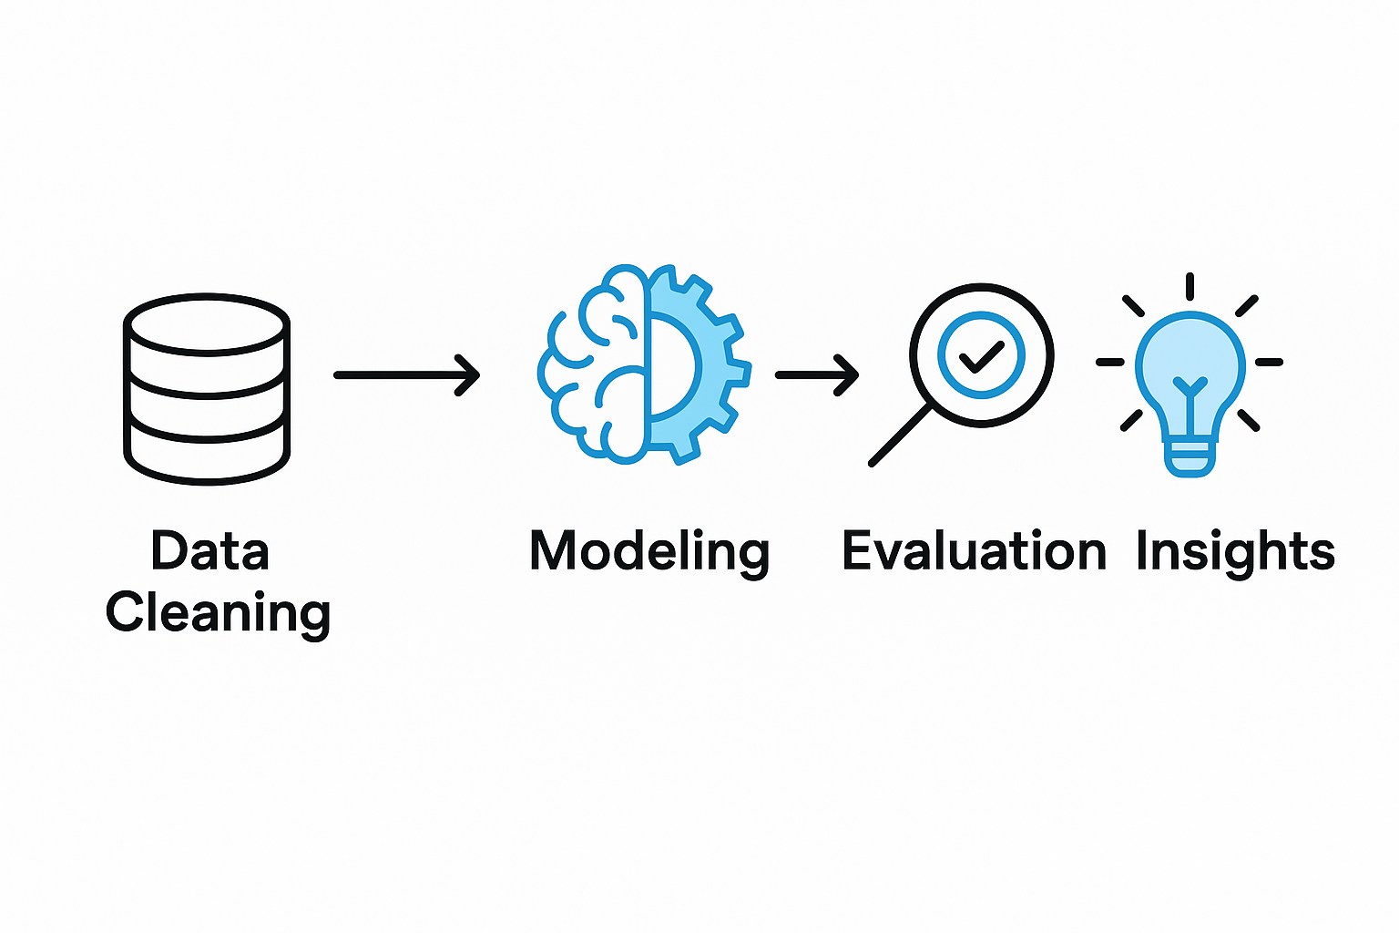
Our Approach
Cleaned and explored ABC Wireless’ customer data to identify patterns.
Built predictive models (Logistic Regression, Random Forest).
Evaluated model performance for accuracy and reliability.
Delivered actionable recommendations to reduce churn.
“A data-driven strategy to help ABC Wireless retain more customers.”
Notes:
We used a data-driven approach, starting with cleaning and exploring the customer dataset. From there, we built and compared predictive models, focusing on accuracy and interpretability.

Slide 4
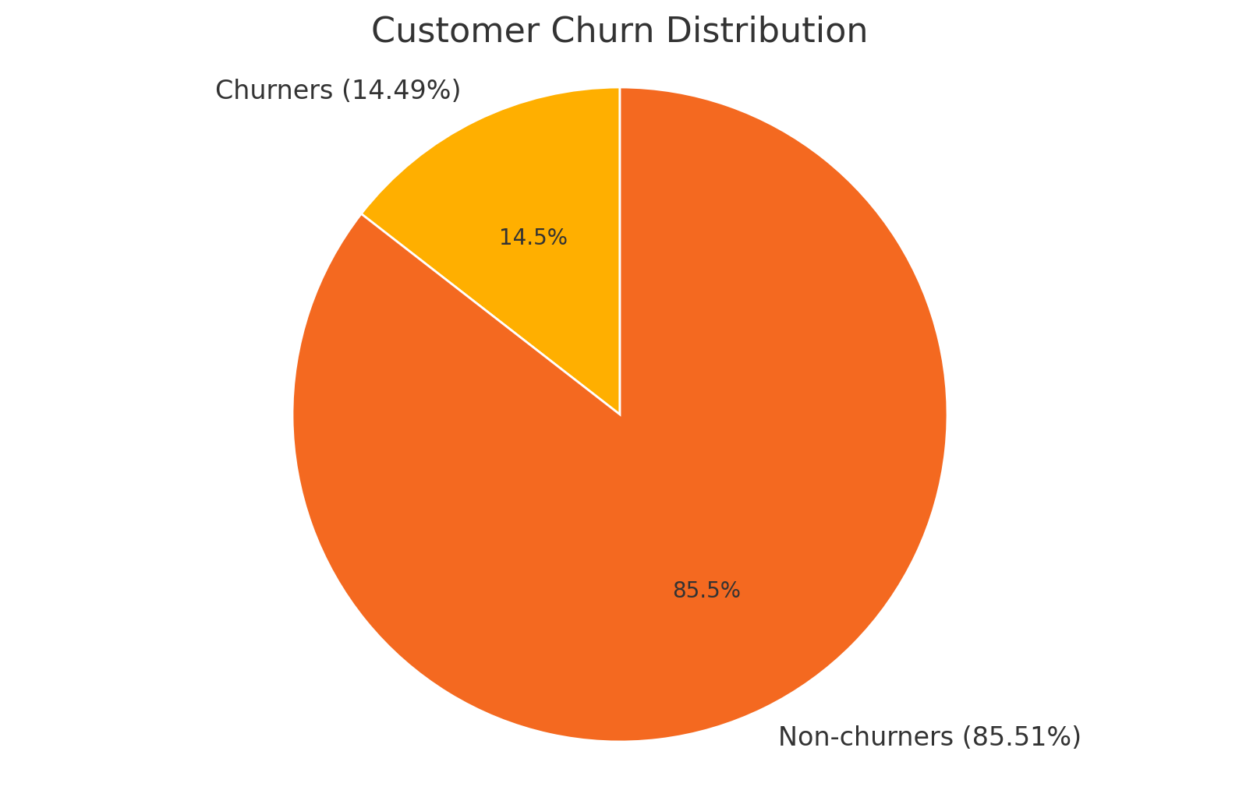
What We Discovered
Churn rate: ~ 14.49% of customers churned
Top churn drivers:
﻿﻿High customer service call frequency
﻿﻿No international plan
Slightly lower daytime minutes/day charge
The model predicts churn with good accuracy (AUC = 0.81), showing it effectively distinguishes between churners and non-churners.
Notes:
About 14.5% of customers churned. We found key churn drivers: frequent customer service calls, no international plan, and usage patterns. Our model achieved an AUC of 0.81, a strong predictive performance.

Slide 5
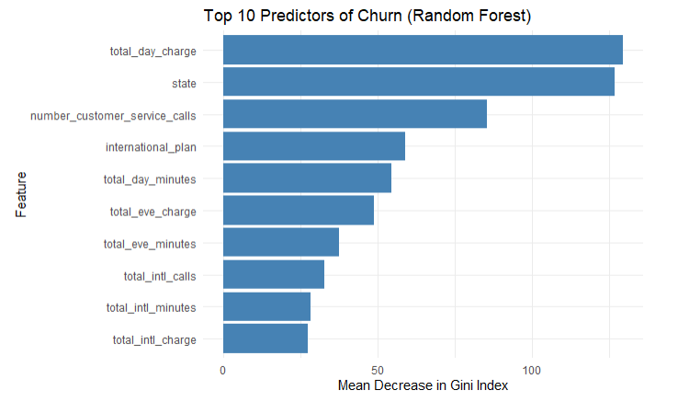
Insights That Matter
Total Day Charge:
Higher usage (and charges) correlates with churn
Number of Customer Service Calls:
More calls = higher churn risk (frustration indicator)
International Plan:
Customers with this plan are more likely to churn
Voicemail Plan:
Customers with voicemail were less likely to churn
Total Intl Calls:
Small but meaningful predictor — global users may churn differently
Churned customers often showed signs of dissatisfaction (e.g., repeated service calls) or had premium features like international plans that may not have met expectations.
Notes:
This plot shows the top predictors of churn. Unsurprisingly, frequent customer service calls and international plan status were leading indicators. We also found usage charges played a role.

Slide 6
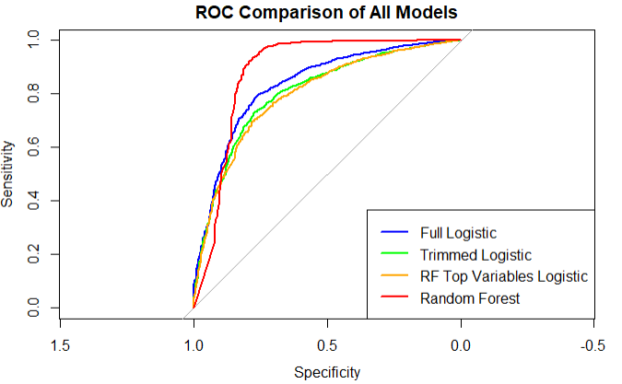
Model Comparison: Performance vs. Simplicity
Model | AUC | Notes
Full Logistic Regression | 0.844 | Most accurate, includes all variables
Trimmed Logistic Model | 0.813 | Simpler, easier to explain
RF-Guided Logistic Model | 0.813 | Based on top features from random forest
Random Forest | ~0.95 | Most powerful, less interpretable
Notes:
All models performed well, with AUC values between 0.81 and 0.84. The slight drop in AUC from the full model to the trimmed and RF-guided models represents a reasonable tradeoff for simplicity and interpretability. Random Forest further validated the key predictors of churn.

Slide 7
Predictions for New Customers
Scoring dataset: 1,600 unlabeled customer records
Predictive model assigned churn probability (0–1) to each
345 (21.56%) flagged as high churn risk
Median churn probability: > 1%
Patterns suggest high churn risk is linked to:
No voicemail plan
Use of international plans
High customer service call volume
Model enables targeted outreach for retention
Notes:
We applied our model to 1,600 new customers and found that around 21.56% are at high risk of churning, with a median churn probability of >1%.
Key risk factors include no voicemail plan, international plan usage, and frequent service calls.
These results help ABC Wireless identify who’s most likely to leave — and act fast with targeted retention efforts.

Slide 8



What This Means for ABC Wireless
ABC can target high-risk customers with retention offers.
Prioritize improvements to customer service processes.
Potential to reduce churn and increase lifetime customer value
Notes:
By identifying high-risk customers early, ABC can improve customer service interactions and offer targeted incentives, potentially reducing churn and boosting customer value.

Slide 9
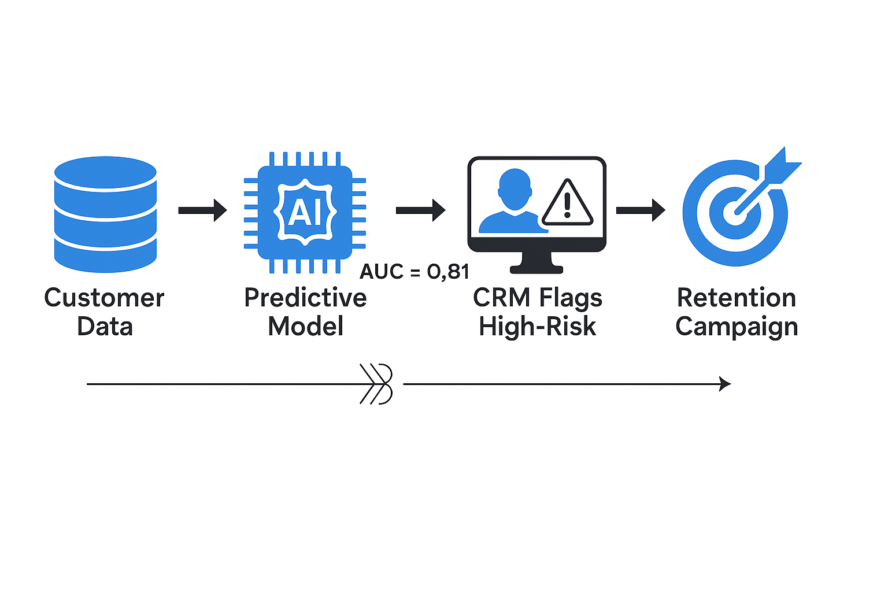
Recommendations
Integrate the predictive model into ABC’s CRM to identify customers at high risk of churn with good accuracy.
Design and launch targeted retention campaigns focused on these high-risk customers to reduce churn.
Continuously monitor model performance and update it as new data arrives, ensuring ongoing accuracy and relevance.
Notes:
We recommend integrating the model into ABC’s CRM, launching proactive retention campaigns, and maintaining the model with updated data for continued performance.

Slide 10
Thank you
QUESTIONS?
Notes:
Thanks for your attention. We welcome any questions about our modeling process, findings, or suggestions.

